Slide 1

Airline Booking System
Simplifying booking, modification, and cancellation.
PRESENTED BY VAIBHAV PATIDAR

Slide 2
Project Overview
Objective
Scope
To design and implement a user-friendly, object‑oriented application that enables passengers to securely search for flights, view ticket prices, and book, modify, or cancel reservations, while providing airline staff with tools to manage flight schedules, seat availability, and pricing—all using in‑memory data storage and following sound software design principles.
The Airline Booking System facilitates user-friendly flight reservations, cancellations, and modifications for passengers, while enabling airline staff to manage flights, ticket prices, and seat availability. It supports notification alerts and secure user access. The system is designed for local execution without external databases, ensuring modularity, clarity, and easy future scalability

Slide 3
Functional Requirements
Passenger Registration/Login: Secure access for passengers
Staff Registration/Login: Access to Staff
Flight Search & Booking: Find and book available flights
Reservation Management: Modify or cancel existing bookings
Notifications: Alert users about updates or changes
Staff Operations: Manage flights, update seat availability and ticket prices
Reservation Overview: Staff can view all bookings made

Slide 4
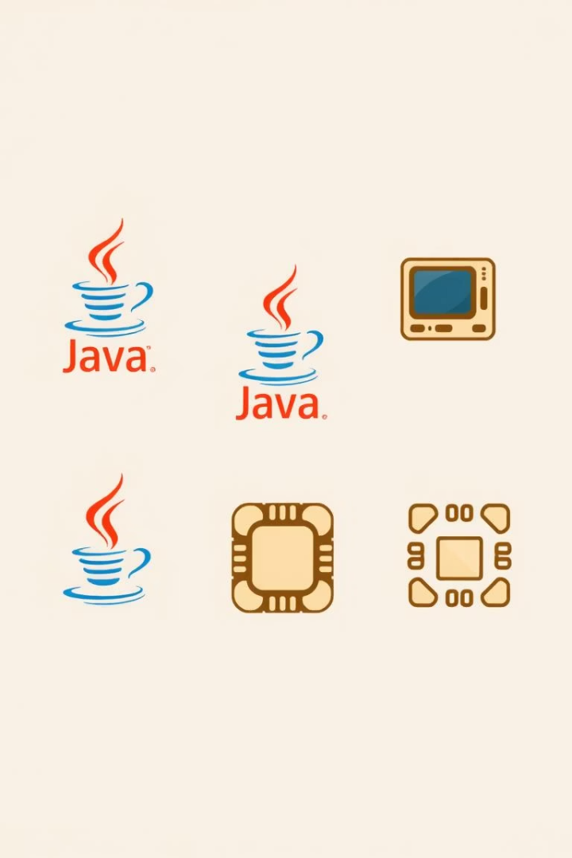



Technology Stack
Java
Java Swing
Local Memory
Primary programming language.
For user interface.
Data storage solution.

Slide 5
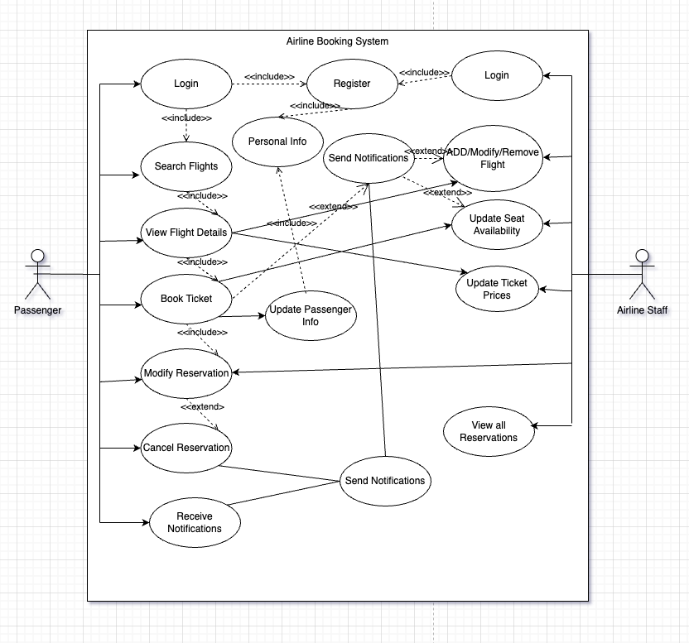
Use Case
Diagram

Slide 6
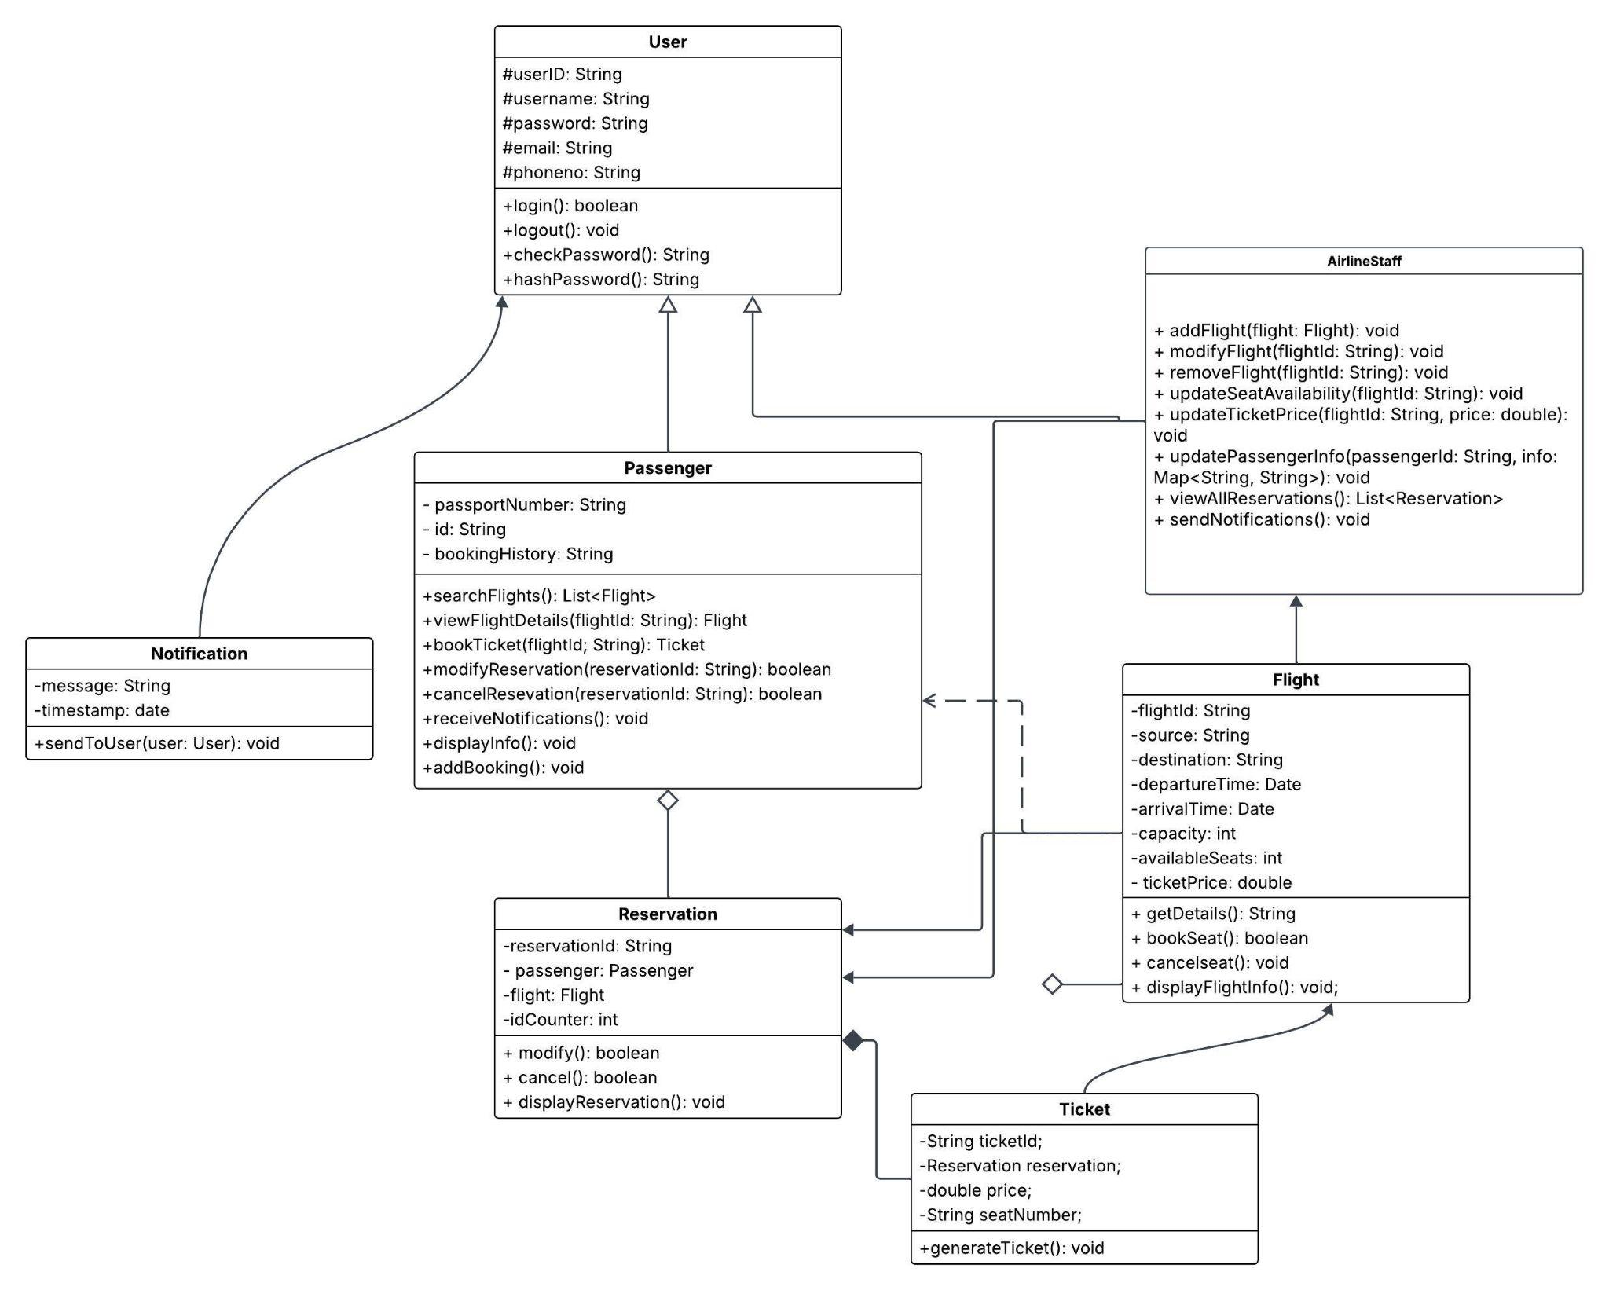
Class Diagram

Slide 7
Design Principles
Low Coupling: Modules are independent
High Cohesion: Each class does one job well
Encapsulation: Sensitive data is private/protected
Abstraction: Common logic abstracted in base class
Inheritance: User extended into specific roles (Passenger, Staff)

Slide 8
CRC Cards (Class Responsibility Collaborator)
CRC (Class-Responsibility-Collaborator) cards help in defining the role and interaction of each class in the system using three aspects:
Class | Responsibilities | Collaborators
Passenger | - Register/Login - Search Flights - Book/Modify/Cancel Reservation | Reservation, Ticket, Flight
AirlineStaff | - Add/Update Flights - Modify Ticket Pricing - View All Reservations | Flight, Reservation
Flight | - Store Flight Details - Track Seat Availability | AirlineStaff, Passenger
Reservation | - Store Booking Info - Link Passenger with Flight - Generate Ticket | Passenger, Flight, Ticket
Ticket | - Store Ticket ID, Seat No, Price - Print Ticket Details | Reservation, Flight
Notification | - Alert Users on Status/Changes - Send Booking Confirmations | Passenger, AirlineStaff
User (abstract) | - Common login/credential management functionality for Passenger and AirlineStaff | Passenger, AirlineStaff

Slide 9
Key Screens
Passenger Info Input Screen
Allows new users to register with personal details like name, email, contact number, and ID.
Existing users can log in securely with a username and password.
Validates input and provides error messages for incorrect entries.
Booking Forms
Displays a list of available flights with filters (destination, date, time, airline).
Passengers can select flights, choose seats, and view ticket prices.
Booking confirmation generates a reservation record and ticket.

Slide 10
Modification Forms
Enables passengers to view and modify their existing bookings.
Fields like flight date, seat number, or destination can be changed (as per project scope).
Provides an option to cancel a reservation completely, with a confirmation dialog.
Admin/Airline Staff Dashboard
Accessible only by airline staff through secure login.
Allows staff to add, update, or delete flight records.
Staff can also update seat availability and ticket pricing dynamically.

Slide 11
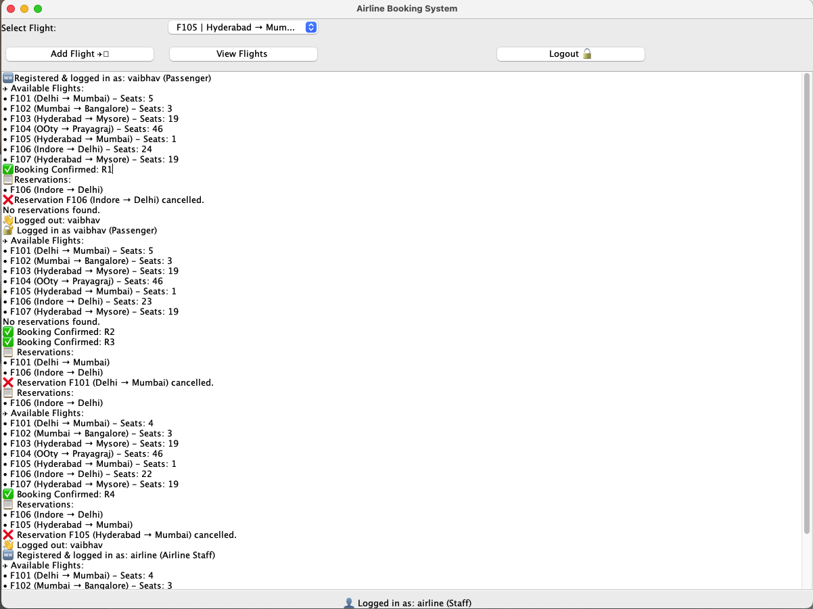
System Interface
Staff View
Passenger S1
Passenger S2
Staff

Slide 12
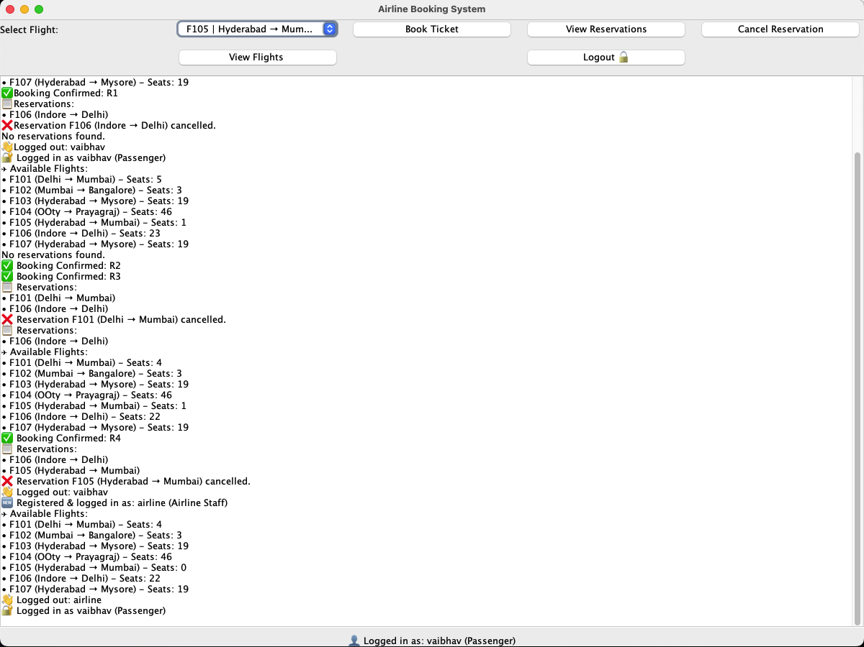
System Interface
Passenger’s View

Slide 13
Challenges & Considerations
Data stored only in memory: No permanent persistence
Handling constraints like no partial booking modification
Integrating ticket pricing without violating cohesion
Ensuring clear role separation between passenger and staff
Keeping the system simple but scalable

Slide 14
Conclusion
Developed a functional, object-oriented airline booking system
Met course requirements using good software design practices
Supported clear user and admin roles
Future enhancements can include:
Payment gateway
Real-time seat tracking
Database integration

Slide 15
THANKYOU

